Slide 1


MEDI 7400
Transition to Practice
Introduction to year 4

Slide 2


Slide 3


Slide 4
Overview
Who’s Who in year 4
Year 4 Structure, Pathways and Calendar
Clinical Immersion Terms – Preparation for Practice Phase
Longitudinal Learning Program
Prescribing Skills
Brief Assessment Overview
Pre-internship Term

Slide 5
School | Year 4 Deputy Heads of learning Community or Heads of Regional Clinical Units
GBCS | North | Professor Kiran Shekar | The Prince Charles Hospital
 | Central | Dr Kelly Stanton | Royal Brisbane Clinical Unit
 |  | Dr Melanie Underwood | Greenslopes Clinical Unit
 | West | Dr Trent Cross ( Yr 3&4) | Mater Clinical Unit
 |  | Dr Min Fong ( Yr 3 & 4) | Ipswich Clinical Unit
 |  | Dr Brent Simkus ( Yr 3 & 4)
 | South | Dr Alex Nesbitt | PA Southside Clinical Unit
RCS | Central Queensland | Dr Thiago Moreira | Rockhampton Regional Clinical Unit
 | Wide Bay - Bundaberg | Dr Gina Watkins | Bundaberg Regional Clinical Unit
 | Wide Bay – Hervey Bay | Dr Tamara Rickersey | Hervey Bay Regional clinical Unit
 | Darling Downs - Southwest | Dr John Ridler | Toowoomba Regional Clinical Unit
OCS | Ochsner Learning Community | A/Professor Charles Kantrow | Ochsner Clinical School
 |  | Professor Dodd Denton

Slide 6
Course Coordination
Year 4 Course Coordination Team Convenor | A/Professor David Highton
Senior Student and Academic Administration Officer – Year 4 | Ms. Stacey Shaw
Year 3 and 4 Academic Lead | A/Professor Michaela Kelly
Critical Care Plus
Critical Care – ED, Anaesthesia and Intensive Care Leads | Dr Mick Devlin Dr Madeleine Hanly
Ophthalmology Lead | A/Prof Sonia Yuen
Clinical Extension
Medicine subspecialties Lead | A/Professor Vidya Navaratnam
Rural and remote Medicine Lead | Dr Lucy Barnett
General Practice
General Practice Leads | A/Professor Michaela Kelly Dr Lynne Reid
PLD Elective
Elective Lead | Dr Bella Khaki

Slide 7
Year 4 Structure
PREPARATION FOR PRACTICE
PRE- INTERNSHIP
IMMERSION GROUP A
IMMERSION GROUP B
General Practice
8 weeks
Clinical Extension
8 weeks
Critical Care Plus
8 weeks
Personal Learning & Development (Elective)
8 weeks
L&D week
Pre-internship Term
PRINT
8 weeks
Longitudinal Learning Program
focusing on Intern preparedness
Students need to meet the requirements of the Preparation for Practice phase before they can proceed to the PRINT term

Slide 8
Year 4 Pathways
GROUP | PATHWAY | TERM 1 | TERM 2 | TERM 3 | TERM 4 | TERM 5
A | 1 | General Practice | Clinical Extension | PLD Elective | Critical Care Plus | PRINT
 | 2 | Clinical Extension | General Practice | Critical Care Plus | PLD Elective | PRINT
B | 3 | PLD Elective | Critical Care Plus | General Practice | Clinical Extension | PRINT
 | 4 | Critical Care plus | PLD Elective | Clinical Extension | General Practice | PRINT
Students follow one of four pathways. Once assigned your pathway , the immersion order cannot be changed or swapped.

Slide 9
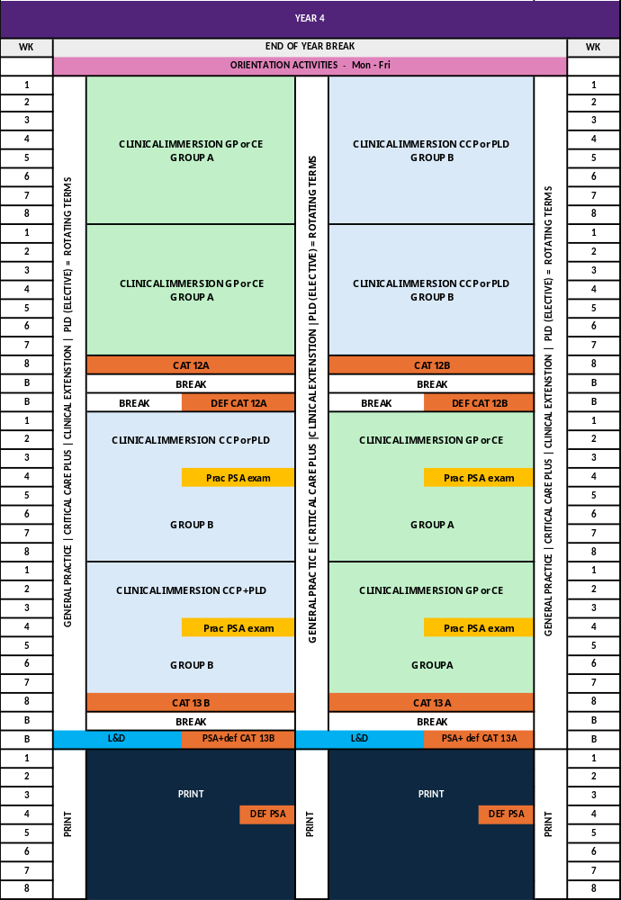
Year 4 Calendar

Slide 10
Clinical Immersion Terms
Preparation for Practice phase

Slide 11
Clinical Immersions - Group A
GENERAL PRACTICE
8 weeks General Practice
Metropolitan (GBCS)
Regional (RCS)
Some Rural & Remote General Practice Opportunities (GBCS+RCS students)
CLINICAL EXTENSION
8-weeks – Rural Generalist, Med Specialty placements
Students will undertake this placement outside of their usual LC
Clinical Extension = term for OCS students to return to Australia
Many GBCS students will undertake CE in a Regional / Rural hospital
5 places per term are reserved at OCS for Australian students - medical specialties
Special Consideration to stay in place – e.g. health reasons or carer responsibilities
Although you complete either a rural generalist or medical specialty placement - all students will be provided with and assessed on the same suite of learning resources across different specialty areas to support your intern preparedness
CE Destination | Student’s Clinical School
 | GBCS | RCS | OCS
RRM Hospital | ✓ | ✓ | ✓
Regional Hospital | ✓ | Different LC | ✓
GBCS Hospital | Different LC | ✓ | ✓
OCS | ✓ | ✓ | No
GP in RRM LOCATION (GPiRL)
EXTENDED PLACEMENT PROGRAM - small number of extended rural placement opportunities for students who ELECT to undertake this experience – BOTH Clinical Extension & General Practice in rural location (16 weeks) with the option to extend to 24 weeks by including your PLD Elective.

Slide 12
Clinical Immersions – Group B
CRITICAL CARE PLUS
Emergency Medicine - 4 weeks
Anaesthesia - 2 weeks
Intensive Care – 1 week
Ophthalmology – 1 week or equivalent
PERSONAL LEARNING & DEVELOPMENT (ELECTIVE)
UQ affiliated hospital elective
Self-arranged
International Exchange
Elective (Personal Learning & Development Term) - Medical School - University of Queensland

Slide 13
Longitudinal Learning Program

Slide 14

Longitudinal Learning Program
The acutely unwell patient
Critical Care
Safe prescribing
Medicine
Ward call
Medicine
Multimorbidity
General Practice
Runs alongside the year 4 clinical immersions
Focused on enhancing your preparedness for Internship
Work through common intern scenarios and tasks - group learning with a clinician
Opportunity to support students to make a safer and less stressful transition to internship
A core aim of medical student education is to prepare medical graduates to start work safely as junior doctors working under supervision, including taking on clinical responsibility, working in teams, and managing the pace of work and sometimes stressful and demanding situations Australian Medical Council

Slide 15
LLP - units of learning
Preparatory component
Online
Application component
F2F tutorial or self- directed online module
Reinforcement component
Online MCQ Quizzes

Slide 16
LLP- composition
Centred on preparing students for their internship – focusing on clinical skills and tasks required of junior doctors that are relevant to all contexts of medicine – scenario-based, case-based, task-based learning activities
Learning Series | Resource development and/ or coordination | No of Units | Application Component
 |  |  | F2F tutorials | Self-directed-on-line
Acutely Unwell Patient | Mayne Academy of Critical Care | 6 | 4 | 2
Safe Prescribing | Mayne Academy of Medicine | 6 | 4 | 2
Ward call |  | 6 | 4 | 2
Multimorbidity + Whole Person Care | Mayne Academy of General Practice | 6 | 4 | 2

Slide 17
Prescribing Skills Assessment
Brief Overview

Slide 18
Enhancing Prescribing Preparedness
Prescribing is a complex task, and medication errors cause serious harm to patients. Approximately one third of adverse events during inpatient care relate to medication.
Junior doctors write most prescriptions in hospital but unfortunately demonstrate an error rate of 10%.
In response Prescribing Safety Assessment was developed by the British Pharmacological Society with demonstrable impact on prescribing errors.
15 medical Schools in Australia participate in this assessment
PSA Prep
Support your understanding of the exam structure and question design
Clinical Pharmacology
Cover clinical pharmacology to support safe prescribing
Reinforce year 3 modules
Prescribing Skills
Focus on prescribing skills
Complements immersion and LLP learning

Slide 19
Prescribing Skills Assessment
Scheduled, timed 60-item Practice exam (sit at least once) | Friday week 4 Term 3 | Friday week 4 term 4
Prescribing Skills Exam | Main sitting Wednesday Learning & Development Week | Deferred PSA week 4 PRINT
PSA Milestones
Orientation Week
Complete PSA Prep modules
End of Term 2
Completed 1 x 30 item practice exam achieved 80% or above
End of Term 3 Completed 2 x 30 item practice exams achieved 80% or above
End of Term 4 Completed 1 x scheduled timed 60 item exam
PRINT
Reflect on & analyse PSA results - address deficiencies
L&D Week
PSA EXAM

Slide 20
Year 4 Assessment
Brief Overview

Slide 21
Year 4 Assessment
WORKPLACE-BASED ACTIVITIES
CUMULATIVE ASSESSMENT TESTS
PRESCRIBING SKILLS ASSESSMENT (PSA)
Mini-CExs
Patient-focused Assessment
Supervisor Report
Professional Development Portfolio
Clinical skills passport
CAT 12 (A or B)– students will complete after their first two terms
CAT 13 (A or B)- students will complete when they have completed the first four terms
Learning from LLP units contribute to CATS
Preparation activities
PSA prep modules
2 x 1hr practice PSA tests (30 item)
Clinical Scenarios
1 x 2-hour timed practice test (60 items)
Exam
2-hour PSA (60 item)
Multimedia Presentation – PLD
(Elective)

Slide 22
Pre-internship Term ( PRINT)

Slide 23
Pre-internship Term (PRINT)
Final phase of student learning - capstone experience
Culmination of intern preparedness activities focusing on easing the transition from medical student to Intern
Learning and Development week precedes PRINT - workshops, panel discussions and lectures provided by UQ staff and external medical organisations to prepare students for the next phase of their medical career. During this week, the Prescribing Skills Assessment written exam will take place as well as some hospital orientation activities.
The Pre-intern will work within a clinical team, carry out a small load of intern-like duties ( as determined by each clinical team) under close supervision, will participate in rosters and duties of the team
8-week clinical immersion – mostly PGY1/2 accredited clinical placements in UQ affiliated hospital
Students’ will provide an EOI to undertake this term at their Intern hospital
When Intern placements are confirmed – aim to meet EOI where possible
PRINT term 2027 commences September 20th
Queensland Health Intern - 2027 Campaign
Intern category | Offer | Must accept
General Intern applicants Group A | 15th July | 17th July
Rural generalist | 13th July | 15th July
Applicant groups B to D | 20th July to 30th July | 1st August

Slide 24
PRINT
ASSESSMENT
PROFESSIONAL DEVELOPMENT PORTFOLIO
PRE-INTERN EDUCATION
Supervisor report x 2 – mid term and end of term
Intern task and skills – sign off - for example:
      Common intern procedures
      Intern tasks
Learning Plan – to be shared with supervisor
Prescribing Skills Assessment – reflection of results and how you have addressed any knowledge gaps
Participation – pre-intern education activities
Completion of modules
Debrief opportunities
Clinical reasoning – ward call and undifferentiated presentations
Clinical documentation and handover practice
Cultural capability – further development
Health and wellbeing strategies
A core aim of medical student education is to prepare medical graduates to start work safely as junior doctors working under supervision, including taking on clinical responsibility, working in teams, and managing the pace of work and sometimes stressful and demanding situations. Australian Medical Council
Notes:
This table summarises the assessment in the PRINT

Slide 25
Thank you and we look forward to seeing you next year!

