Slide 1
Year 4 2027
Allocation Process and Timeline
Rachael Appleby
Coordinator, Work Integrated Learning (WIL)

Slide 2

What will I be preferencing?
Round | What | When
SC & EOI | Special Consideration EPP & GPiRL | July 2026
Round 1 | Term Order Clinical Extension Pathway | August 2026
Round 2 | Clinical Extension Placement (Location & Discipline) | September 2026
Elective | All Terms | Self Arranged – Apply 12 weeks prior UQ Immersion – Preference 8 weeks prior
GP | Term 1 & 2 Placements | Sept/Oct 2026
 | Term 3 & 4 Placements | Mar/Apr 2027
PRINT | EOI & Preferencing | Jul/Aug 2027
Timeline, Block & Preferencing Dates: https://medical-school.uq.edu.au/key-dates

Slide 3
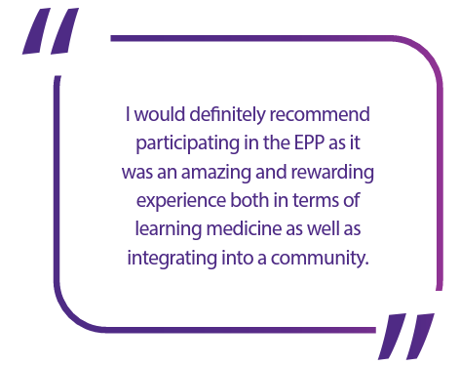
Extended Placement Program & GPiRL
All students may apply to take part in the Extended Placement
Program (EPP) or GP in a Rural Location (GPiRL)
EPP allows students to undertake their General Practice and
Clinical Extension placements back-to-back in the same
rural location (e.g. Term 1 & 2, Term 3 & 4).
Students wishing to undertake EPP or GPiRL will be provided with financial support for accommodation and rural living expenses.
Applications will be open from 6-12 July 2026. Further information, including the application form, can be found here:
https://medical-school.uq.edu.au/current-students/doctor-medicine-students/clinical-immersions

Slide 4
Special Consideration
Circumstances that impact a student's ability to undertake placements at a specific site or in a specific Term Order (i.e. Medical Conditions, Primary Carer Responsibilities).
Not grounds for Special Consideration – accommodation/transport arrangements, financial considerations, family/social events.
Applications will be open from 6-12 July 2026 and must be supported by evidence - outcome will be known prior to preferencing.
If you are unsure, apply anyway!
Further details about eligibility criteria can be found in the Year 4 Allocation Guidelines:
http://medical-school.uq.edu.au/current-students/doctor-medicine-students/key-guidelines

Slide 5
Year 4 Immersion Order
Group | Term 1 | Term 2 | Term 3 | Term 4 | Term 5
1 | PLD Elective | Critical Care+ | General Practice | Clinical Extension | PRINT
2 | Critical Care+ | PLD Elective | Clinical Extension | General Practice | PRINT
3 | General Practice | Clinical Extension | PLD Elective | Critical Care+ | PRINT
4 | Clinical Extension | General Practice | Critical Care+ | PLD Elective | PRINT

Slide 6
Clinical Immersion Locations
Students can apply for their immersions to be undertaken at specific locations available withing their Learning Community. See Clinical Immersion Guidelines for further details.
Clinical immersions will primarily be located within your Learning Community. Where clinical immersion experiences are not available in your Learning Community, they will be scheduled at a facility that offers the appropriate opportunities to meet the learning outcomes.
Students can view the immersion locations offered within each Learning Community here: https://medical-school.uq.edu.au/current-students/doctor-medicine-students/clinical-immersions

Slide 7
Clinical Extension Pathways
Clinical Extension Pathways
Rural & Remote
Rockhampton
Hervey Bay
Bundaberg
Toowoomba
Central Learning Community
South Learning Community
North Learning Community
West Learning Community
Ochsner Clinical School
  Students are required to undertake their Clinical Extension outside of their Learning Community.
  Students can preference from the following pathways ->
  A minimum of 50% GBCS Domestic students are required to go to a Regional, Rural or Remote location.
  Accommodation & travel subsidies will be provided for students in Regional, Rural or Remote locations.
  Students can apply for Special Consideration.
  A list of the available disciplines available at each Learning Community will be available on the website:
https://medical-school.uq.edu.au/current-students/doctor-medicine-students/clinical-immersions

Slide 8
Swaps
One swap per student, following the release of allocations (25-30 August 2026)
Students can swap their just their Clinical Extension Pathway (with someone in the same Term) or entire allocation (including Clinical Extension Pathway)
Application form is available here:
https://medical-school.uq.edu.au/current-students/doctor-medicine-students/key-guidelines/clinical-immersion-guidelines
Both students are eligible and intending to progress to the following year of the MD program
Swapping with a student who is not progressing or is planning to take an IOS is not permitted

Slide 9
Clinical Extension – Location & Discipline
Students will preference for their specific placement location and discipline within their allocated pathway.
    GBCS Learning Communities – InPlace Preferencing
    Rural & Remote – InPlace Preferencing
    RCS Learning Communities – arranged locally
    OCS – arranged locally
There is a summary of the placements typically available at each Learning Community on the Placements website: https://medical-school.uq.edu.au/current-students/doctor-medicine-students/clinical-immersions
Preferencing | Allocation
7-13 September 2026 | 21 September 2026

Slide 10
General Practice
Students will preference for their specific placement location as follows:
    RCS students will preference / be allocated to a GP Practice by their Learning Community
    GBCS students will preference via InPlace
GPiRL & EPP placements will be allocated during the EOI process
 | Preferencing | Allocations
Term 1 & 2 | 28 Sept – 4 Oct 2026 | 19 October 2026
Term 3 & 4 | 29 Mar – 4 Apr 2027 | 19 April 2027

Slide 11
PLD Elective – Self Arranged
Students are also able to undertake a self-arranged elective placement somewhere other than a UQ Learning Community and are responsible for sourcing, funding and arranging their own placement.
Applications are due at least 12 weeks prior to commencement of your Elective Term. This ensures enough time to get the appropriate approvals, and ensure a Student Placement Agreement (SPA) is in place.
Students should not make travel arrangements until final approval has been received.
Application details can be found on the website, along with information on where past students have secured their electives:
https://medical-school.uq.edu.au/current-students/doctor-medicine-students/clinical-immersions/elective-personalised-learning-development-term
Note! If a student is not allocated to a placement 4 weeks prior to commencement of their Elective Term, they will be required to select one of the remaining UQ opportunities.

Slide 12
EOI – Ochsner/UQ-affiliated GP locations, apply up to 12 weeks prior.
Preferencing – UQ Learning Communities, preference via InPlace 8 weeks prior:
You can find a tentative list of available UQ Elective immersion on the website:
https://medical-school.uq.edu.au/current-students/doctor-medicine-students/clinical-immersions/elective-personal-learning-development-term
Note! UQ Electives are to be taken in their entirety and cannot be split.
PLD Elective – UQ Learning Community
https://medical-school.uq.edu.au/key-dates

Slide 13
PRINT
Students can express interest to be placed at their:
    Internship Location (if it is a UQ affiliated hospital)
    Ochsner Clinical School (if you have passed USMLE Step 1 and Step 2 CK)
Once internships are released, EOI placements will be allocated, if available.
All other students will be allocated to an immersion location within their Clinical School.

Slide 14
Timeline – Onshore Students
Task | Dates (2026)
Special Consideration Process | 6-12 July
Applications for Extended Placement Program | 6-12 July
Preferencing for Term Order & Clinical Extension Pathway | 3-9 August
Release of allocations to students | 24 August
Students apply for placement swaps | 25-30 August
Placement swap outcomes | 31 August
Timeline, Block & Preferencing Dates: https://medical-school.uq.edu.au/key-dates

Slide 15
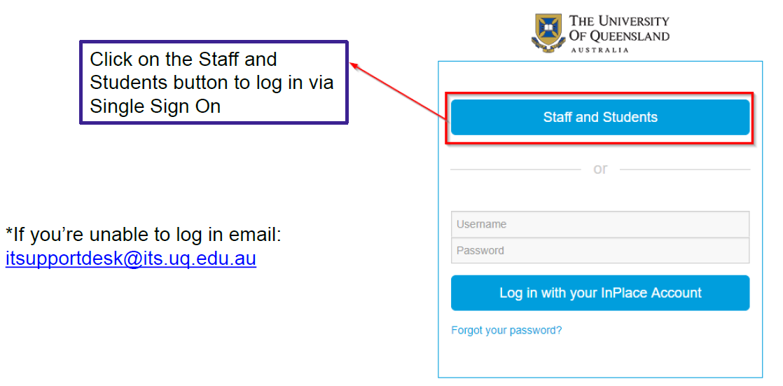
The Placements System - InPlace
Logging into InPlace - https://placements.uq.edu.au/

Slide 16
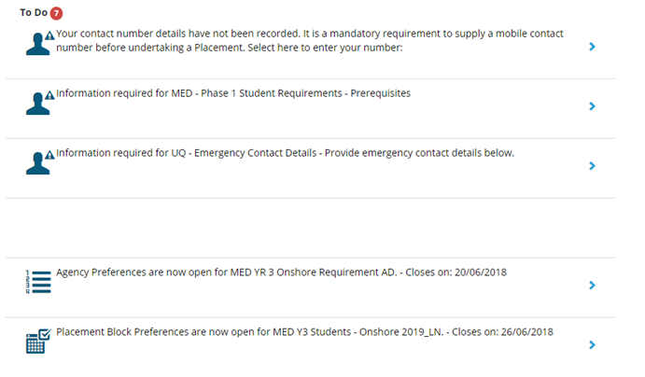

Preferencing
This will appear on your ‘To Do’ list once preferencing has opened.
Agency/Provider Preferences = Clinical Extension Pathway
Placement Block Preferences = Immersion Order (which will determine Elective Term)

Slide 17
Clinical Extension Pathway Preferencing
In the Placements system, each pathway is represented by a placeholder:
.
Placeholder - Clinical Extension (Ochsner) | Placeholder - Clinical Extension (Rural)
Placeholder - Clinical Extension (South LC) | Placeholder - Clinical Extension (Rockhampton)
Placeholder - Clinical Extension (North LC) | Placeholder - Clinical Extension (Toowoomba)
Placeholder - Clinical Extension (Central LC) | Placeholder - Clinical Extension (Bundaberg)
Placeholder - Clinical Extension (West LC) | Placeholder - Clinical Extension (Hervey Bay)

Slide 18
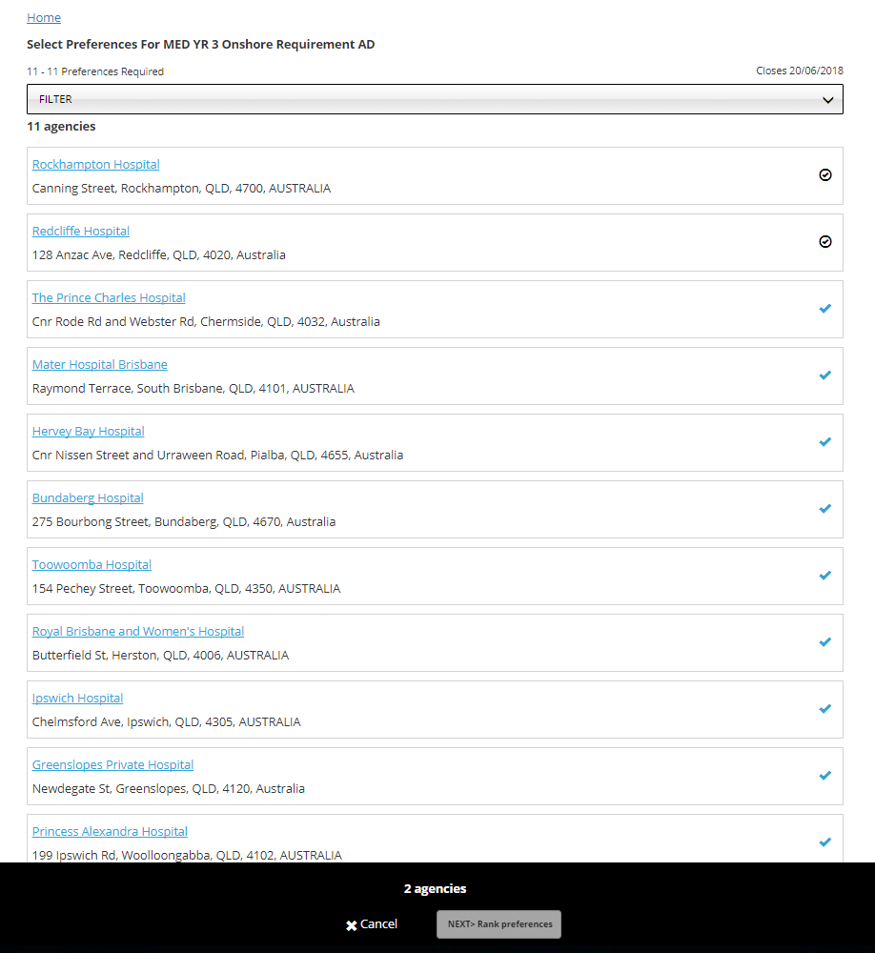
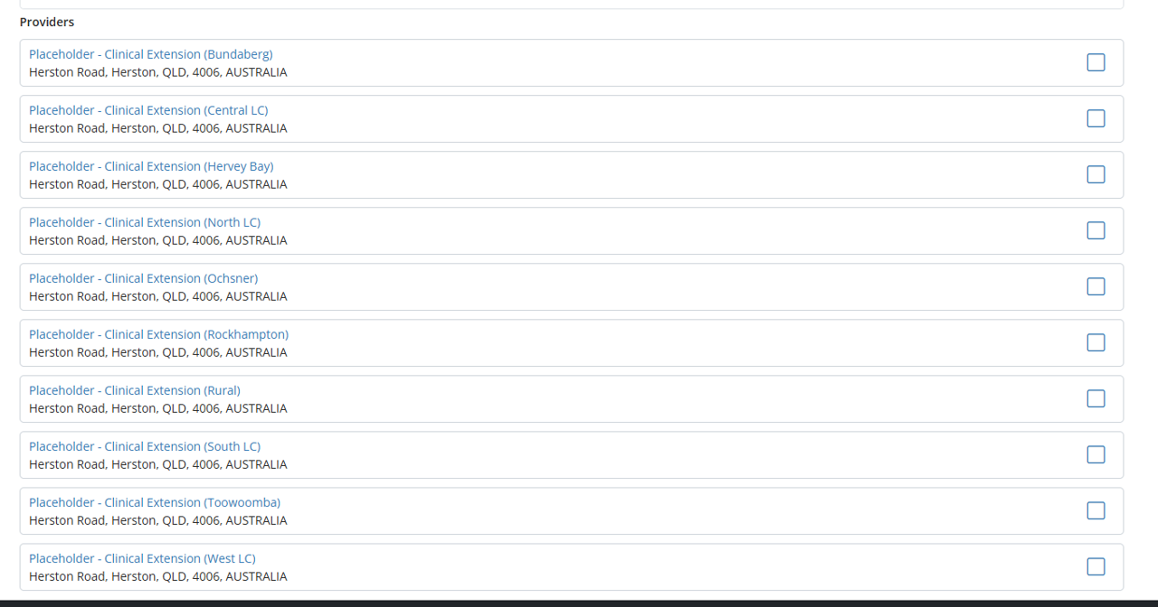

Select All Items
1
Once you’ve clicked the Agency Preferences link this screen will appear.
Select ALL items displayed by clicking the blue ticks
Once all items have been selected the Next button will become available to click
Click the next button to proceed to the
next screen
2
10
3

Slide 19
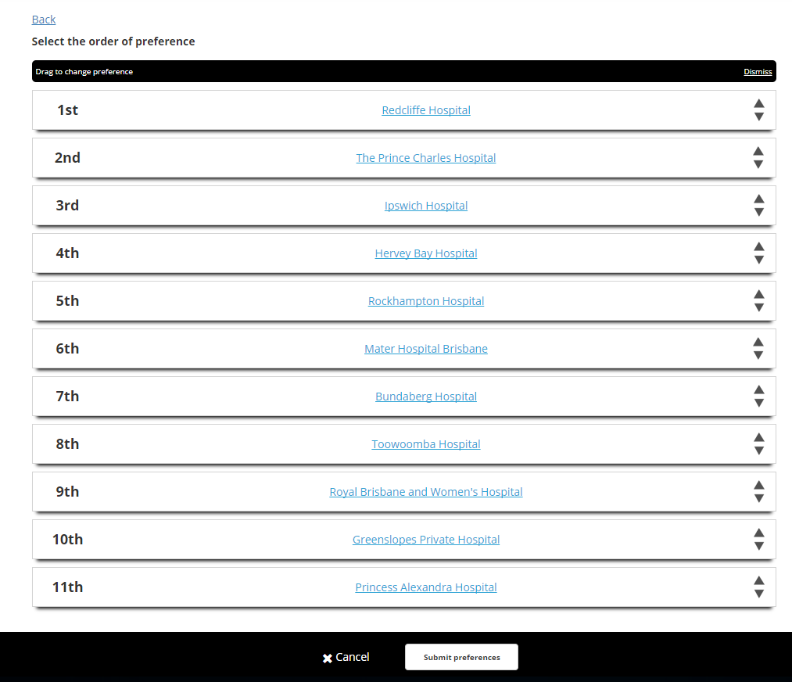
Rank Preferences
Arrange all items in your chosen order:
Put your CURRENT LC LAST!
Note: You can drag or use the arrows to move the order around
Once happy with the order click the submit preferences button
1
You can come back and change your preference order at any time until preferencing closes (NB. they will be displayed in alphabetical order, not the order you preferenced in).
Once preferencing closes, you will not be able to go back and see how you preferenced – take a screenshot!
2

Slide 20
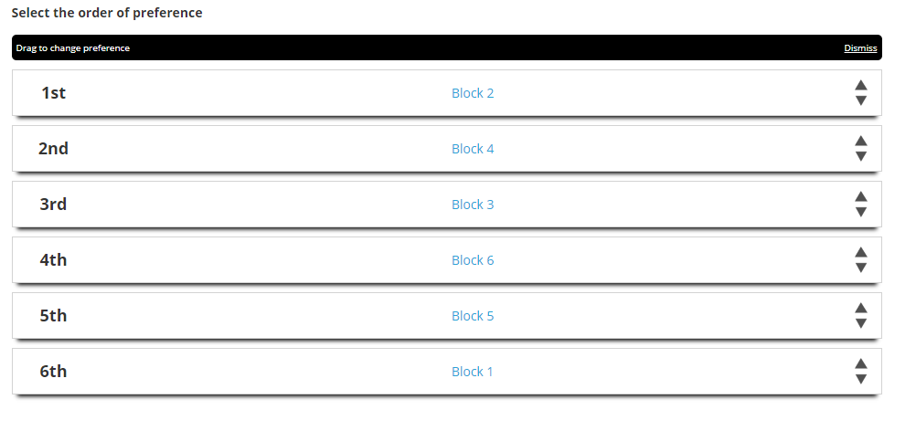
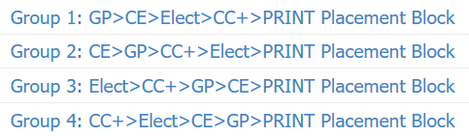
Placement Order (Group) Preferencing
Placement Order: Rank, in order of preference, your Group.
IMPORTANT!
The system will give as many students as possible their highest possible preference for Elective Term
Once Elective Term in confirmed, the system will then allocate students to their highest possible preference for Clinical Extension Pathway.
All Clinical Extension Terms will have the same number of placements available for each Pathway.

Slide 21
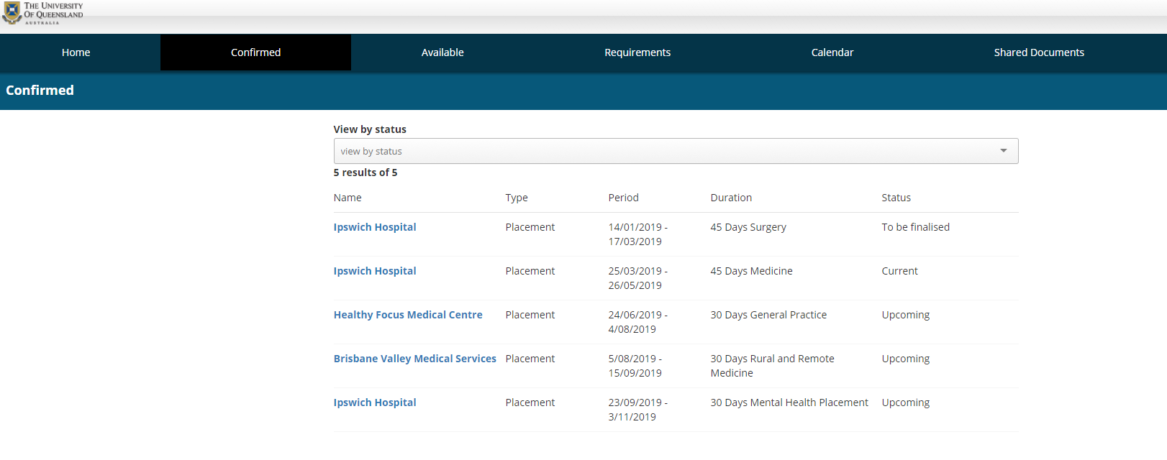
Confirmed Placements

Slide 22
Closing Notes & Information
Timeline, Block & Preferencing Dates: https://medical-school.uq.edu.au/key-dates
Allocation Guidelines: http://medical-school.uq.edu.au/current-students/doctor-medicine-students/key-guidelines
Clinical Immersion Information: https://medical-school.uq.edu.au/current-students/doctor-medicine-students/clinical-immersions
It is the student’s responsibility to be aware of the relevant deadlines and submit applications within the required timeframe. Keep an eye on your emails for announcements!

Slide 23
Thank you
Questions?
med.placements@uq.edu.au

