Slide 1
InPlace
Preferencing Guide
Guide for MD Students on Preferencing in InPlace

Slide 2
Contents
1.0 | What do I preference in my program? | P.3
2.0 | InPlace | P.5
3.0 | Preferencing | P.8
4.0 | Locating your allocation | P.12
This handbook is designed to help MD students navigate the placement system, InPlace.
It provides essential information on preferencing and understanding your allocations.

Slide 3
01
What do I preference in my program?
Information on what is preferenced during the Doctor of Medicine program.

Slide 4
1.1 What will I preference in InPlace?
What will I preference?
The preferences you make will depend on which year of the program you are in.
See the table below for an outline of what you may preference.
Program Year
Year 2 | Longitudinal General Practice (GP) Clinical Immersion*
Year 3 | Immersion Order Rural Clinical Immersion**
Year 4 | Immersion Order and Clinical Extension Pathway Clinical Extension Location and Department General Practice* Elective
*Greater Brisbane Clinical School students only
** Rural Clinical School students only

Slide 5
02
InPlace
How to find, log in and navigate the placement system, InPlace.

Slide 6

2.1 Logging into InPlace
To preference for your Learning Community and clinical immersion term, you will first need to log into the placement system, InPlace. You can access InPlace via my.UQ or through the below URL:
https://placements.uq.edu.au/
Click on the Staff and Students button to log in via ‘Single Sign On’ (using your UQ student credentials)
Need help with logging in?
help@its.uq.edu.au

Slide 7
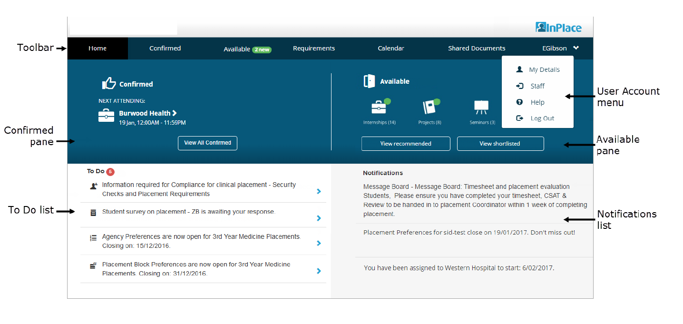
2.2 InPlace Home Screen Navigation

Slide 8
03
Preferencing
How to preference in InPlace.

Slide 9

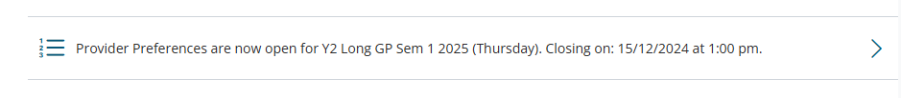
3.1 Preferencing – where to find it
You can find the preference links in the InPlace 'To Do' list at the bottom left corner of the home screen once preferencing is open. An example showing a link to Y2 Longitudinal General Practice preferencing is below.
.
Please ensure you select the correct link for your preferencing
Note!
Students may see additional links in their ‘To Do’ list, such as those for Unpaid Work Experience.
Ensure you select the correct link for preferencing, as these other links relate to different opportunities.

Slide 10
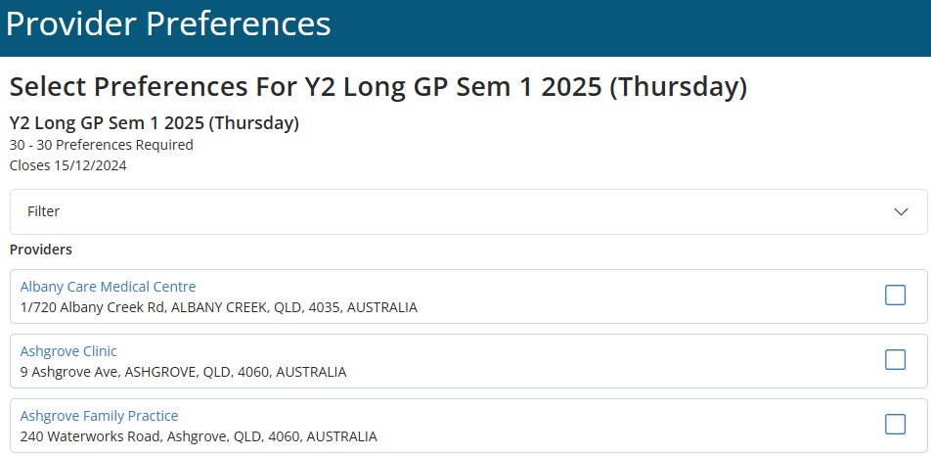

3.2 Preferencing – how to guide
Once you’ve clicked the Provider Preferences link this screen will appear.
Select the your preferred providers by clicking the blue squares.
Note! You need to select the minimum preferences as highlighted in the red box before InPlace will allow you to select ‘rank’.
Click the rank button to proceed to the next screen.
1
Note: All preferences must be selected to move to the next screen to rank.
2

Slide 11
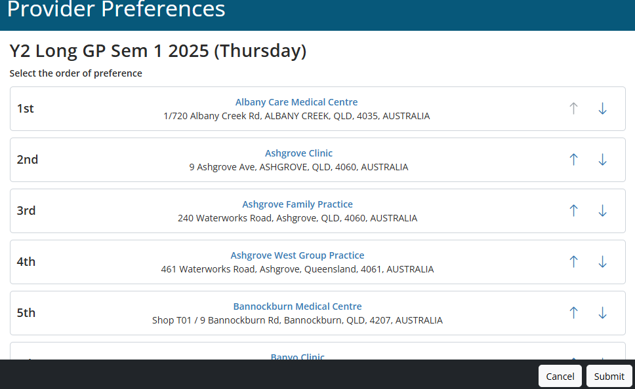
3.3 Preferencing – ranking providers
Arrange the providers into your chosen preferencing order.
Once happy with the order, click the ‘submit preferences’ button
1
Note: You can come back and change your preference order at any time until preferencing closes.
If you come back to modify your preferences it is important to note that they will be displayed in alphabetical order not the order you preferenced in.
Note: You can drag or use the arrows to move the order around
2

Slide 12
04
Locating your Allocation
Where to find, and see your allocations

Slide 13
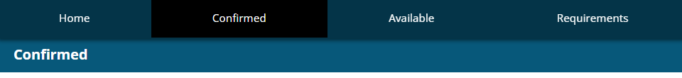
4.0 Locating your Allocation
Where can I see my allocation?
Your allocations will be visible in the placement system, InPlace, in the confirmed pane once allocations are released to students.
Once allocations have been released to students, your allocated clinical immersions will appear in the ‘Confirmed’ pane on the Placement System Home screen

Slide 14
Contact
The Work Integrated Learning (WIL) Team
Faculty of Health, Medicine and Behavioural Sciences
med.placements@uq.edu.au
CRICOS 00025B

