Slide 1

Are you a GP registrar interested in teaching UQ medical students in your practice?
Dr Beth Shirley FRACGP
Senior Lecturer at Specialty Supervisor (General Practice) at UQ

Slide 2
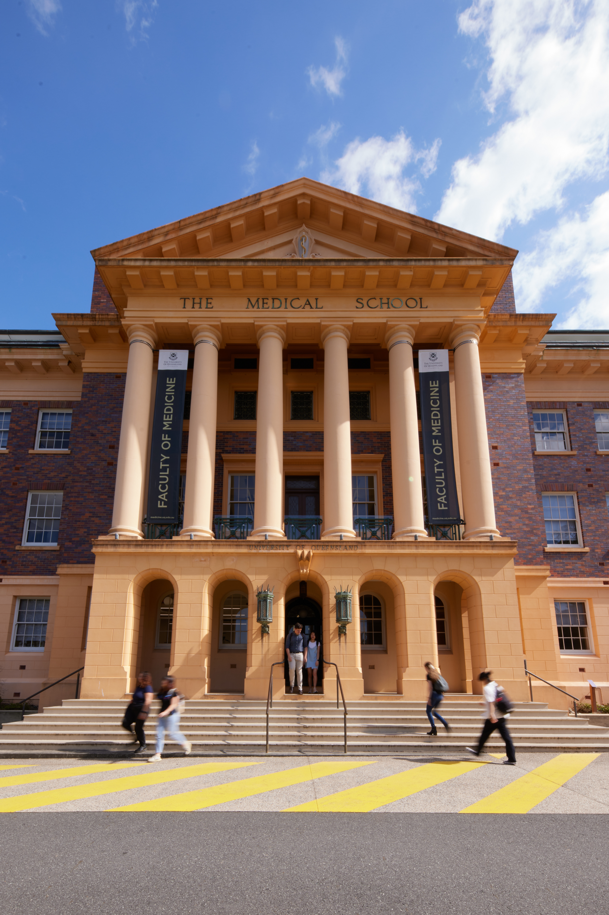
2025 UQ medical student teaching opportunities:
Year two student longitudinal placement in general practice:
  Students are timetabled to attend one day per week (min 6 hours) for 15 weeks
  Early clinical experience for students
  Two placements run per year (one each semester)
Year four student block placement in general practice:
  30 sessions (session = min 3 hours) spread over 6 weeks (~ 5 sessions per week/2.5 days)
  6 blocks run per year (3 per semester)
  Students are rotating through other clinical immersion experiences in Year 3 and 4.

Slide 3
Why we value GP registrar teachers
Kelly M, Sturman N, Green A, Ryan C, Shirley B, Chau A, Preston S, Jackson C. Wanted: Nearer peers for teaching and learning in general practice. Aust J Gen Pract. 2024 Dec-Supplement;53(12 Suppl):S98-S100. doi: 10.31128/AJGP-04-24-7235. PMID: 39693760.
Link to full article in AJGP here.
Pilot study in 2023 where Year 2 UQ medical students were placed with a GP registrar and specialist GP teacher for 7 weeks each (14 week placement). Students, GP registrars, specialist GP teachers and GP supervisors were then given opportunities to provide feedback on experience in surveys, focus groups and semi-structured interviews.
Findings suggested that near peer teaching in this context was beneficial for both the GP registrar and the medical students.

Slide 4

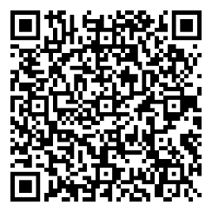
Support for GP Teachers:
General Practice Clinical Unit (GPCU) staff available to give support via:
  Email
  Phone
  Practice visits
  Zoom visits
The GPCU Teaching and Learning webpage has many teaching
    related resources including the Handbook for GP Teachers
    If you read one resource the Handbook would be a good choice!
We run at least two Dinners at Herston UQ per year:
  Mid year – Educational Dinner
  End of year – Awards and Thank You Dinner
GPCU Teaching and Learning webpage

Slide 5

Academic Title Holder (ATH) with UQ
GP Teachers are encouraged to apply for ATH
Benefits include:
• Acknowledgement of your contribution with a title of Lecturer
• UQ library access, including access to eTherapeutic Guidelines and the Australian Medicines Handbook – big savings on subscriptions!!
• Option to sign up for a UQ Fitness Passport, which gives access to sporting facilities around Brisbane at a reduced cost
• Opportunity for closer involvement in the MD Program – participate in the OSCEs, Multiple Mini Interviews, Personal Advisor Network

Slide 6
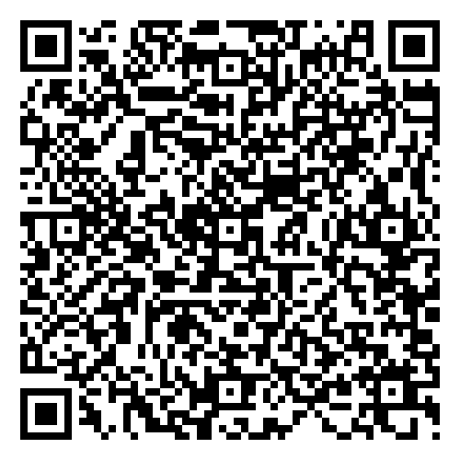
Interested?
Over half of the RACGP registrar training practices in Brisbane also teach UQ medical students on their GP placements and UQ would love for you to be involved!
To find out if your practice takes UQ medical students on placement and to express your interest please click here or scan the QR code to fill in the expression of interest form. Alternatively, you can email med.mdgp@uq.edu.au
Expression of interest form for GP registrars

