Slide 1
Information for New UQ GP Teachers
2025

Slide 2
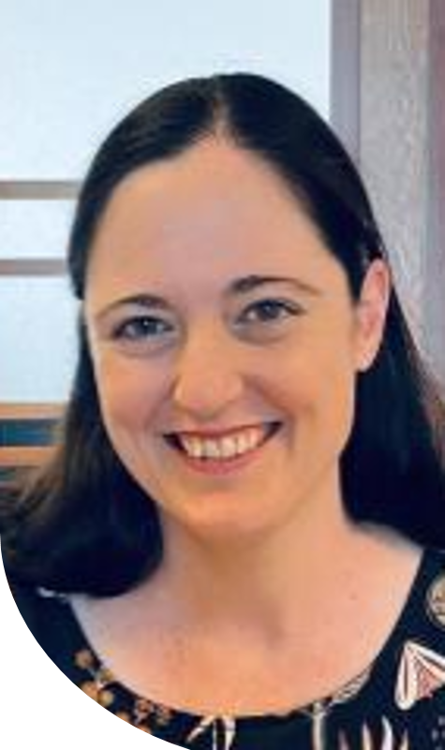
Introductions
Dr Beth Shirley
Senior Lecturer and Specialty Supervisor at the General Practice Clinical Unit (GPCU)
GP Recruitment

Slide 3
The University of Queensland Doctor of Medicine (MD):
4 year post graduate degree
Change to curriculum implemented for Year 1 in 2023 and is up to Year 3 in 2025.
Teaching out Year 4 of previous curriculum in 2025.
Full cohort of new curriculum by 2026
International and local students
3

Slide 4
The General Practice clinical placements incorporate student learning about:
the discipline of general practice;
primary health care and its integration with community, secondary and tertiary contexts, and the roles of primary care practitioners;
Access to a broad spectrum of clinical presentations encountered in general practice;
the assessment, diagnosis and management of common and important problems presenting in General Practice;
how personal and community contexts influence people’s health and well-being, and the importance of relationship-based whole person care; and
the use of evidence to guide clinical decisions.

Slide 5
2025 UQ medical student teaching opportunities:
Year Two Longitudinal GP Placement:
Students are timetabled to attend one day per week (min 6 hours) for 15 weeks
Early clinical experience for students
Two placements run per year (one each semester)
Year Four Block GP Placement:
30 sessions (session = min 3 hours) spread over 6 weeks (~ 5 sessions per week/2.5 days)
6 Blocks run per year (3 per semester)
Students are rotating through other clinical immersion experiences in Year 3 and 4.

Slide 6
Benefits for GP Teachers:
CPD
Academic Title Holder (ATH) with University of Queensland
Eligible for Teaching PIP Payments

Slide 7
RACGP CPD for Teaching:
RACGP will approve up to a maximum of 30 hours CPD per GP per year for involvement in teaching:
15 hours Educational Activity
15 hours Reviewing Performance.
GPCU can provide a letter confirming practice provision of clinical placements for medical students at the end of each semester.
Self-log your CPD in RACGP CPD app as you complete it.

Slide 8
Academic Title Holder (ATH) with UQ
GP Teachers are encouraged to apply for ATH – process outlined in Handbook, Need CV, APHRA number
Benefits include:
• Acknowledgement of your contribution with a title e.g. Senior Lecturer
• UQ library access, including access to eTherapeutic Guidelines and the Australian Medicines Handbook – big savings on subscriptions!!
• Option to sign up for a UQ Fitness Passport, which gives access to sporting facilities around Brisbane at a reduced cost
• Opportunity for closer involvement in the MD Program – participate in the OSCEs, Multiple Mini Interviews, Personal Advisor Network
8

Slide 9
Practice Incentive Program (PIP) Teaching Payments
Practice Incentives Program (PIP) Teaching Payments may be claimed by the practice for UQ clinical sessions that the students spend under your supervision or the supervision of your GP colleagues in accredited practices.
PIP forms will be emailed to the practice at the beginning of the placement.
Further information can be found linked in the Handbook for GP Teachers.

Slide 10
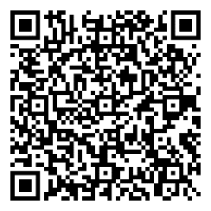
Support for GP Teachers:
General Practice Clinical Unit (GPCU) staff available to give support via:
Email
Phone
Practice visits
Zoom visits
The GPCU Teaching and Learning webpage has many teaching related resources including the Handbook for GP Teachers
If you read one resource the Handbook would be a good choice!
We run at least two Dinners at Herston UQ per year:
Mid year – Educational Dinner
End of year – Awards and Thank You Dinner
GPCU teaching and learning webpage

Slide 11
Support for Students:
Please contact us via med.mdgp@uq.edu.au if you have concerns about your student, for example:
Frequent absenteeism
Concern after incident in general practice
Concern about academic progress, professionalism, fitness to practice etc
Concern about mental health of student
11

Slide 12
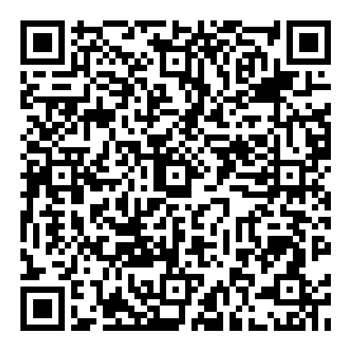
Medical School Student Support Team:
UQ has a range of resources for students in need of support. These include a dedicated website
W: https://medical-school.uq.edu.au/current-students/medical-school-student-support-team-0
E: med.mss@uq.edu.au
T: 1300 275 870
All appointments are confidential. In person or Zoom options. After hours crisis support: 1300 851 998
Can provide support with:
Pastoral needs (e.g. individualised advice and referral to other services for accommodation and financial advice)
Generic academic and learning needs (e.g. mentoring, time management and skills development)
Physical and mental health needs
International needs (e.g. adjusting to life in Australia)
Medical School Student Support Team
12

Slide 13
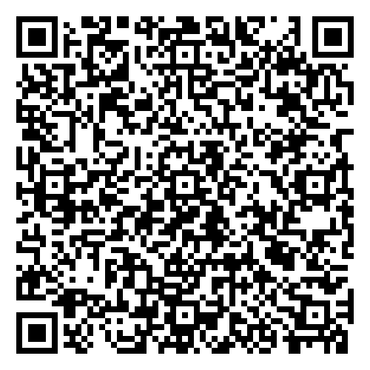
Getting started checklist
Please fill in an expression of interest form linked here or scan QR code. Alternatively email us at med.mdgp@uq.edu.au
If you are in a GP practice that is new to taking UQ medical students, we will be in contact to arrange a practice visit and take you through next steps.
If your practice already takes UQ medical students, please chat to your practice manager to let them know you are interested in teaching. We usually send general correspondence to the practice via the practice manager.
Check your medical indemnity covers you for supervising medical students
Read the Handbook for GP Teachers linked on the GPCU 'Teaching and Learning' webpage to find out more information or scan QR code.
New GP Teacher Expression of Interest form
GPCU 'Teaching and Learning' webpage.
13

Slide 14
Questions?
If further questions please email:
med.mdgp@uq.edu.au

