Slide 1
What's New for GP Teachers in 2025

Slide 2
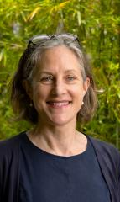
Welcome
Professor Katharine Wallis
Mayne Professor and Head Mayne Academy of General Practice
Head General Practice Clinical Unit
Notes:
Welcome.
Acknowledgement of Country and Diversity Statement.
General comments around change of curriculum.
Need for more GP teachers and thanks for help.

Slide 3
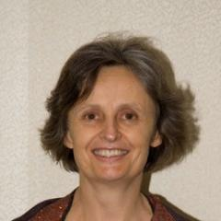
General Information Update
Associate Professor Nancy Sturman
Associate Professor, General Practice Clinical Unit

Slide 4
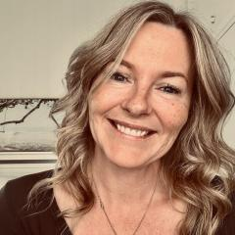
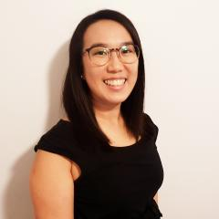
Academic Coordinators for General Practice Course 2025
Associate Professor Nancy Sturman
Dr Lynne Reid
Dr Annabel Chau

Slide 5
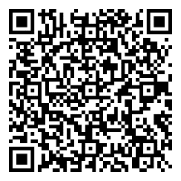
Contact email & GP Teacher Handbook
For all enquiries and concerns please email:
med.mdgp@uq.edu.au
The updated Handbook for GP Teachers for 2025 is available via the ‘Teaching and Learning’ page on the GPCU website linked here or QR code:
GPCU Teaching and Learning webpage

Slide 6
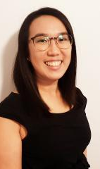
Year 2 GP Longitudinal Placement
Dr Annabel Chau
Senior Lecturer, General Practice Clinical Unit

Slide 7
Year 2 GP Longitudinal Placements
2025
1 day/week, 15 weeks
Regular GP teacher
First clinical exposure
Supported with 2 tutorials
Assessment designed for learning
Notes:
Difficult conversation scenarios include references to sexism, racism, doctor-patient boundaries, gifting, professionalism,

Slide 8
Assessment for Year 2 students done on placement.
2 x Mini-Clinical Evaluation (Mini-CEX)
1 x history, 1 x clinical examination
Appropriate patients for these tasks are required to be chosen by the supervising GP
2 x GP Supervisor reports
Mid & end of placement
Opportunity to provide feedback to the student about their progress of clinical skills and professionalism
5 x Observed Clinical Assessments
Clinical and procedural skills to observe, assist or perform themselves under observation

Slide 9
Examples of Observed Clinical Assessments

Slide 10
Orientation Document:

Slide 11
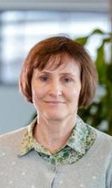
Year 4 GP Block Placement
Associate Professor Michaela Kelly
Associate Professor General Practice Clinical Unit

Slide 12
General Practice Immersion (yr 3 >yr 4) – Transition to the new MD
 | 2024 | 2025 | 2026
Number of students per Block/Term | 50% | 50% | Full cohort
Year of student | half year 3 and half year 4 | year 4 | year 4
Number of weeks | 6 | 6 | 8
Prior student placements In addition to medicine and surgery | Half of students will have completed- O&G, Paediatrics, mental health | Most will have completed, Paediatrics, O&G, Mental Health | All students will have completed Paediatrics, O&G, Mental Health
Program | Old program | Final year of the old MD | First year 4 for new MD

Slide 13
Assessment for Year 4 students done on placement.
Remains the same for 2025
Clinical Participation Assessment (CPA) or Supervisor report
Two CPAs are to be completed and discussed with the student, one in week 3 (mid-block) and one in week 6 (end-block). Please note that while the mid-block CPA is formative, the end-block CPA is a summative assessment and that your student may fail the course based on an unsatisfactory end-block CPA (containing two or more Borderline or any Unsatisfactory ratings).
Please discuss any students to whom you have awarded any “Unsatisfactory”, or 2 or more “Borderline”, ratings on the week 3 CPA, with the Academic Course Coordinator so that we can provide appropriate support .
We strongly recommend that the same GP teacher complete both the mid-block and end-block CPA, where possible. When several GPs at your practice have contributed to the student’s teaching and learning, please seek input from these colleagues before completing the assessments
Workplace Learning Portfolio (WLP)
The overarching principles of the WLP are to provide regular opportunities for students to be observed performing key clinical tasks, and to engage in contemporaneous feedback. Tasks to be completed include DOPS (Direct Observation of Procedural Skills), COPS (Compulsory Observed Procedural Skills) and Mini-CEXs (mini–Clinical Evaluation Exercises)
These tasks are completed using the MyProgress student mobile app – the student will present the form to you on their mobile

Slide 14
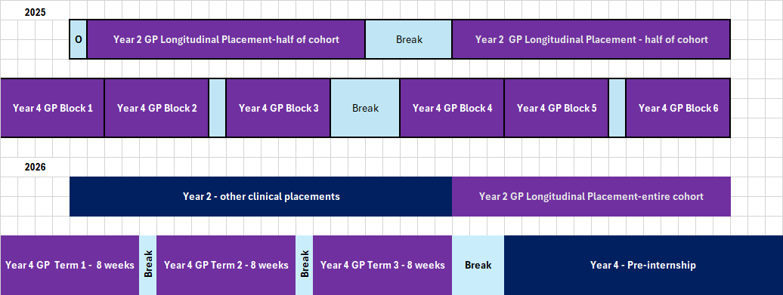
Looking ahead. Comparison of 2025 and 2026.
Notes:
May need to leave this slide out or adjust as not sure about crossover...

Slide 15
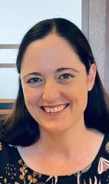
GP Teacher Recruitment
Dr Beth Shirley
Senior Lecturer, General Practice Clinical Unit

Slide 16
We still need more GP Teachers for 2026.
Please spread the word within your practices and networks.
To express interest please email us at med.mdgp@uq.edu.au

Slide 17
Thank you!

