Slide 1
Research in the Department of Nephrology at Ochsner Clinic Foundation
Himanshu Vashistha, PhD
Nephrology Research
Ochsner Health System

Slide 2
Ongoing Studies – Basic Science
The role of p66 in in diabetic nephropathy.
PI: L. Meggs; Sub-PI: H. Vashistha

Slide 3
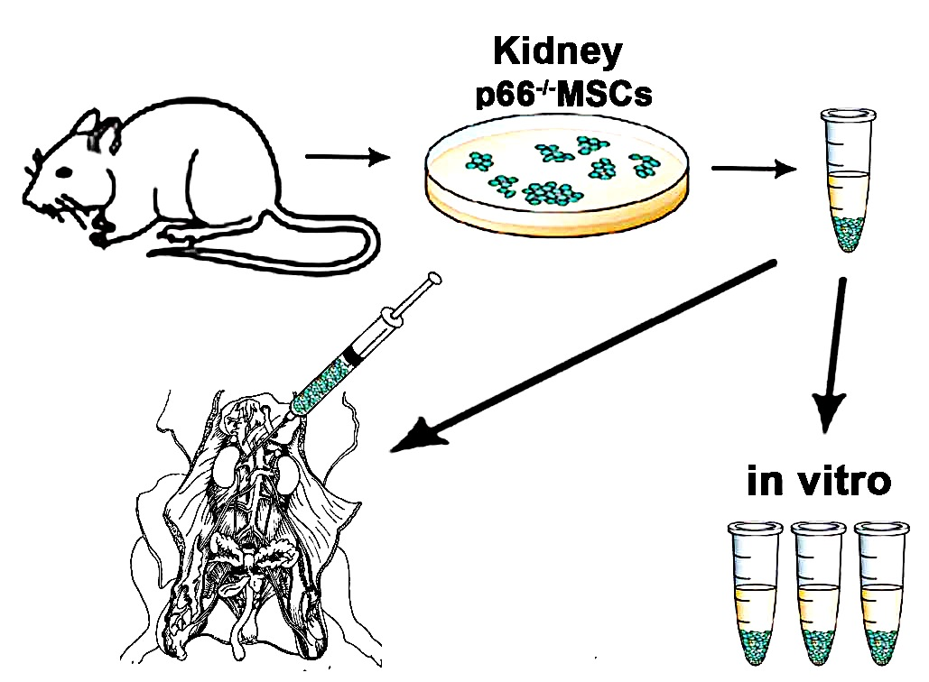
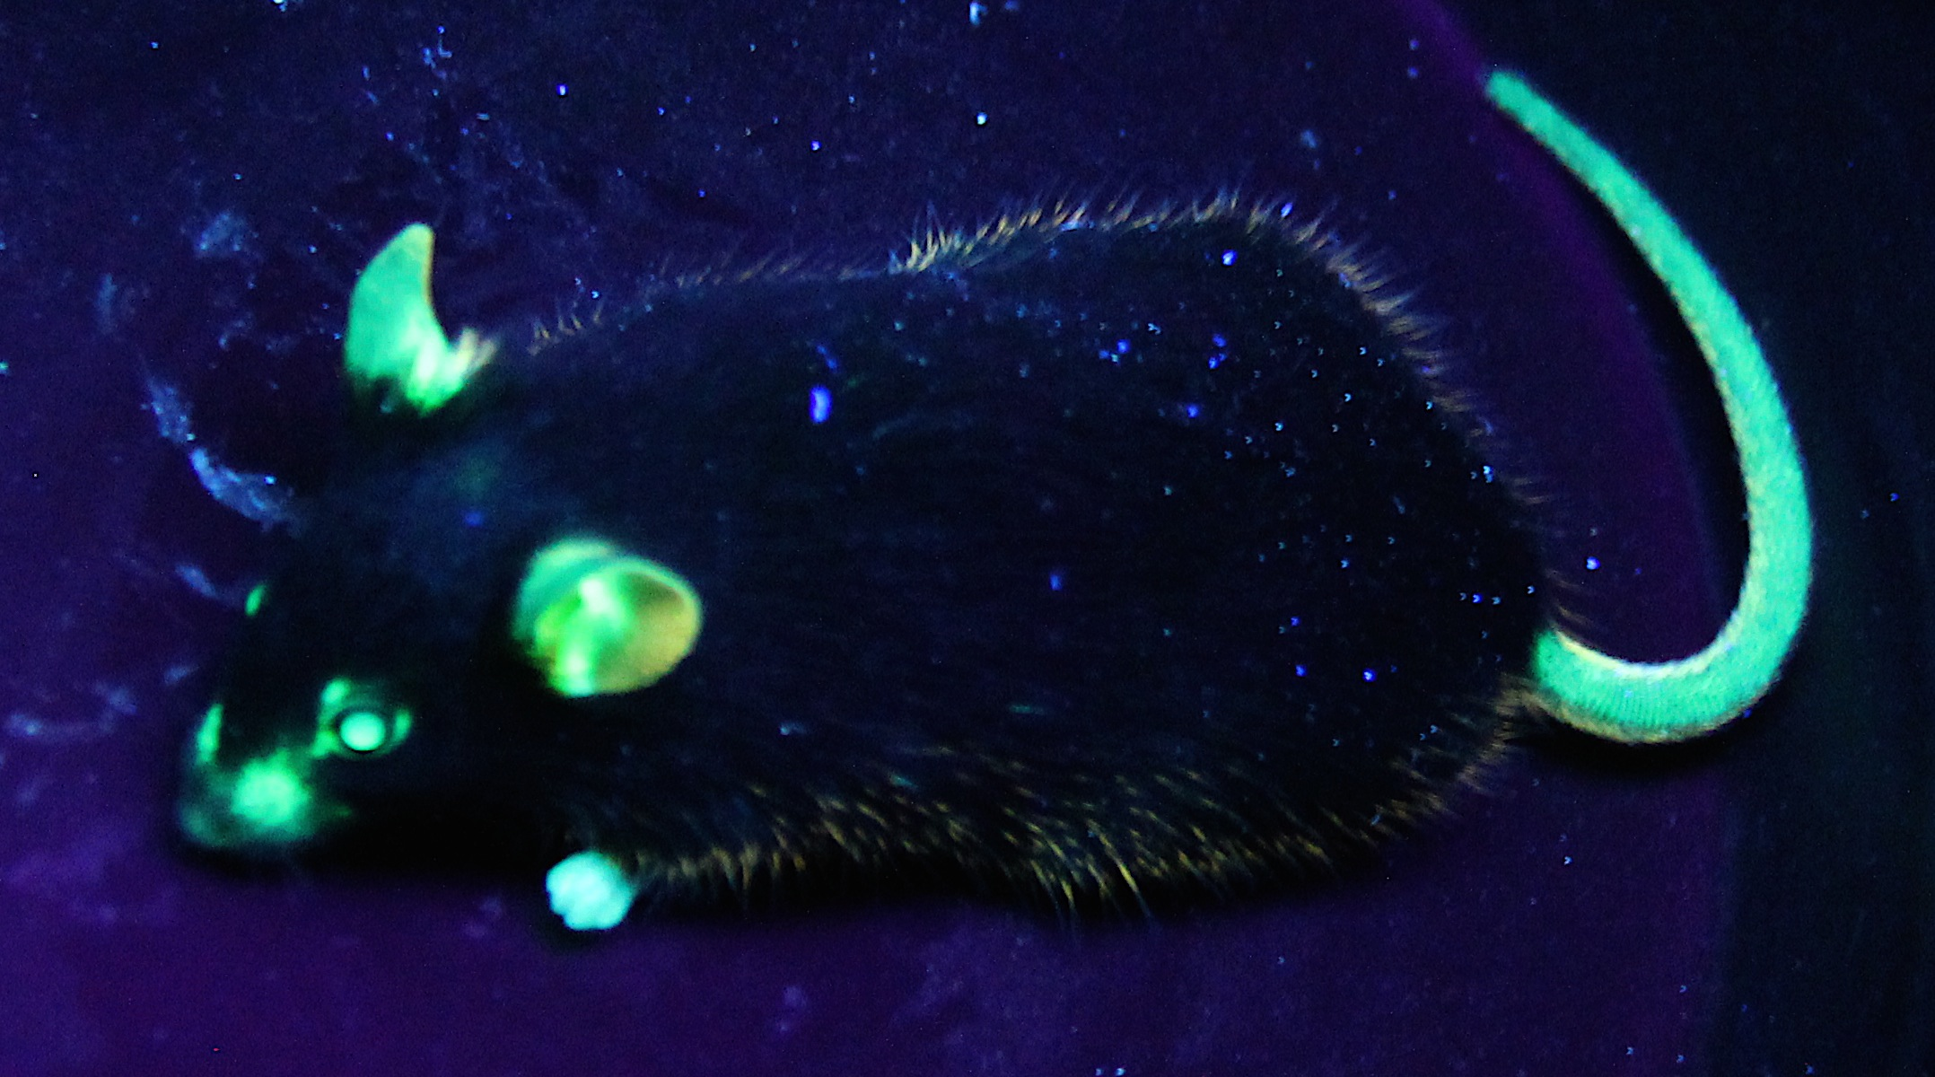
Ongoing Studies – Basic Science
The role of p66 in in diabetic nephropathy.
Notes:
As proof of principal that p66 KO MSCs are renotropic and induce a regenerative microenvironment we plan to inject these cells in to the kidneys of Akita diabetic mouse before and after the onset of diabetic nephropathy.
In order to track these cells we mated our p66 KO mouse with the mice expressing the transgene for Enhance green fluorescence protein and created p66 KO EGFP mouse

Slide 4
Ongoing Studies – Basic Science
Role of proteasome inhibitors in membranous nephropathy
Proteasomes are associated in the pathophysiology and progression membranous nephropathy
Nuclear factor-kappa B (NF-kB) is a crucial transcription factor that regulates the expression of a wide variety of inflammatory genes including Cytochrome P450 (CYP).
Proteasomes degrade IkB which results in the nuclear translocation of NF-kB.
CYP plays a major role in puromycin aminonucleoside-(PAN) induced glomerular injury that mimics a model of Minimal Change Disease (MCD) in humans.
PI: R. Baliga, MD; Sub-PI: H. Vashistha, PhD

Slide 5
Ongoing Studies – Basic Science
Role of proteasome inhibitors in membranous nephropathy
Urine Albumin/Creatinine Ratio
(µg/mg)
PI: R. Baliga, MD; Sub-PI: H. Vashistha, PhD

Slide 6
Ongoing Studies – Basic Science
Reversal of epigenetic changes in podocytopathies
Gene expression is the outcome of Chromatin modifications.
That can be reversed using chemical agents.
Losartan is used as first line therapy for proteinuria >30 years.
PI: P. Singhal (Hofstra North Shore LIJ); Co-PI: H. Vashistha

Slide 7
Ongoing Studies – Basic Science
Aminopeptidase A and intrarenal renin-angiotensin system balance in glomerular disease.
PI: J.C. Velez; Sub-PI: G. Navar (Tulane)

Slide 8
Ongoing Studies – Clinical Research
Glomerular diseases
ACTH in resistant FSGS
Sponsor: Mallinckrodt
PI (site): L. Meggs; Sub-PI: D. Kumbala; Sub-PI: H. Vashistha
Sparsentan as primary therapy for FSGS
Sponsor: Retrophin
PI: JC Velez; Sub-PI: I. Lukitsch
Atacicept in IgA Nephropathy
Sponsor: EMD Serono
PI (site): JC Velez; Sub-PI: H. Vashistha
Voclosporin added to MMF in Lupus Glomerulonephritis
Sponsor: Aurinia
PI: JC Velez; Sub-PI: H. Vashistha
E
SS
IRBs
SS

Slide 9
Ongoing Studies – Clinical Research
Anemia of CKD
Vadadustat in Anemia of ESRD (2 studies)
Sponsor: Akebia
PI (site): [0014, 0015] L. Meggs
Vadadustat in Anemia of CKD (pre-dialysis)
Sponsor: Akebia
PIs: [0016] JC Velez, D. Kumbala; Sub-PI: H. Vashistha
Iron isomaltoside product for CKD
Sponsor: Pharmacosmos
PI (site): L. Meggs
SS
SS
IRBs

Slide 10
Ongoing Studies – Clinical Research
Acute Kidney Injury
Terlipressin in Hepatorenal Syndrome (CONFIRM trial)
Sponsor: Mallinckrodt
PI (site): JC Velez; Sub-PI: G. Therapondos (Hepatology)
Serum NGAL in AKI
Sponsor: BioPorto
PI: JC Velez; Sub-PI: D. Kumbala
Chronic Kidney Disease
NICE Study, endothelial / CKD
Sponsor: LCAT, Tulane University
PI (site): D. Kumbala
SUPER, salt restriction in reduction of proteinuria in CKD
Sponsor: Tulane University
PI (site): D. Kumbala
Neo-Kidney Augment™
Sponsor: RegenMed
PI (site): L. Meggs, Co-PI: I. Lukitsch
BudgA
IRBs
E
E
SS

Slide 11
Ongoing Studies – Clinical Research
Investigator Initiated (in planning stages)
Acute Kidney Injury
Renal perfusion pressure in hepatorenal syndrome, BRAKE (Blood Pressure Rise for Acute Kidney Injury In End-Stage Liver Disease) prospective cohort, ASL MRI RBF Pilot
Sponsor: none
PI: JC Velez; Co-I: G. Therapondos, L. Seoane, E. Rudman
Acute Kidney Injury / End-Stage Renal Disease
Continuous renal replacement therapy and intracranial pressure in stroke
Sponsor: none
PI: I. Lukitsch; Co-PI: O. Iwuchukwu, Sub-PI: M. Gonzalez

