Slide 1
Cardiology Research
Opportunities for Students
Daniel P. Morin, MD MPH
Director of Cardiovascular Research
Ochsner Medical Center / University of Queensland
dmorin@ochsner.org

Slide 2
Cardiology Research
32 Faculty active as principal investigators
107 Active trials (~13 investigator-initiated)
1075 Active trial enrollment
>100 Peer-reviewed publications per year: 2013: 130 2014: 132 2015: 110 2016: 130

Slide 3
Major Areas of Investigation: Cardiology
Echocardiography
Electrophysiology
General/Clinical
Heart Failure
MRI / Imaging
Interventional
Nuclear
Shah, Qamruddin, Lavie
Morin, Rogers
N. Polin
Krim, Mandras
Shah
Jenkins, R. Patel
Bober, N. Polin

Slide 4
Dr. Bober – Nuclear Research Projects
Regional concordance between SPECT and invasive angiography - Chart review and data entry - Excel skills necessary

Slide 5
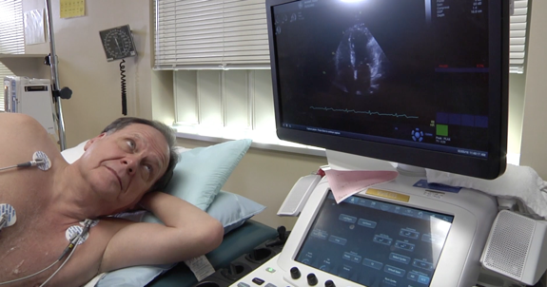
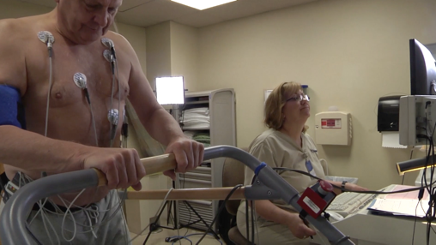
Dr. Shah – Imaging Research Projects
CV Imaging in Staph aureus Bacteremia. Optimization of sequence of imaging. Automation/semiautomation of order sets. Health care utilization / outcomes.
Improving the value of negative stress echo. Patient education about the test. Patient education about fitness benefits.

Slide 6
Recommendations
Talk with cardiologists you know about your interests.
Figure out what you’re interested in. If possible, come up with a project idea!
Make contact: Researcher from the Section of interest, or Dr. Daniel Morin (Director of Cardiovascular Research)
Be enthusiastic.
Be intelligent and realistic.
Work hard.

Slide 7
Major Areas of Investigation: Cardiology
Echocardiography
Electrophysiology
General/Clinical
Heart Failure
MRI / Imaging
Interventional
Nuclear
Shah, Qamruddin, Gilliland
Morin, Rogers
N. Polin
Krim, Mandras
Shah
Jenkins, R. Patel
Bober, N. Polin
Medical Director, Cardiovascular Research: Daniel Morin MD MPH

