Slide 1
Introduction to Clinical Research
Nicole Villemarette-Pittman, PhD
Director, Clinical Research
Associate Professor (Hon), University of Queensland Medical School
Ochsner Health

Slide 2
Objectives
Determine when I am doing human subjects research
1
Be able to formulate a research question
2
Be able to conduct a literature search
3
Understand basic research designs using EMR
4

Slide 3
Am I Doing Human Subjects Research?
Human Subjects Research Defined
Human Subject: a LIVING individual about whom an investigator is conducting research
Human Subjects Research:
Obtains information or biospecimens through intervention or interaction with the individual, and uses, studies or analyzes the information or biospecimens
OR
Obtains, uses, studies, analyzes, or generates identifiable private information or identifiable biospecimens

Slide 4
Examples of Human Subjects Research may include:
Collecting blood
Conducting a survey
Changing participants’ environments
Administering medicine
Interviewing
Administering a psychological test
Collecting data
Conducting a focus group
Testing a new educational technique
Implanting a device

Slide 5
Am I Doing Human Subjects Research?
Clinical Question
Research Question
I think my ALS patients should be assessed with the ALS Functional Rating Scale – will this help me determine the right support services for my patients?
Were ALS Clinic patients, who were assessed with the ALS Functional Scale, matched to support services in less time than those who were not assessed?
A Clinical Question helps me do my work better and directly impacts my individual patients.
A Research Question may offer no promise of benefit to my patients or my practice but may help others.

Slide 6
Am I Doing Human Subjects Research?
Quality Improvement/Process Improvement/Quality Control/Quality Assurance
Safety: Avoid harming patients
Time: Reduce delays for patients and providers
Efficacy: Provide evidence-based care
Efficiency: Avoid waste (equipment, ideas, energy, etc.)
Equity: Provide care that does not vary in quality based on personal characteristics
Patient-Centered: Provide care that respects patient preferences, needs, and values
FOCUS: Process or System or Practice or Methods regardless of the individual characteristics of the members (patients, trainees, providers, etc.)

Slide 7
Am I Doing Human Subjects Research?
Quality Improvement
If I give prophylactic antibiotics 5 days prior to non-traumatic knee replacement surgery, will that have a positive impact on my post-surgical infection rate?
Target=process used to prevent infection in all patients having non-traumatic knee replacement surgery
Intervention=prophylactic antibiotics
Outcome=% of post-surgical infections during the 12 months prior to this process change versus the 12 months after this process change (group level data)
Research
Do my patients who had prophylactic antibiotics 5 days prior to non-traumatic knee replacement surgery have different rates of post-surgical infection compared to those who did not have prophylactic antibiotics?
Target=individual patients
Intervention= prophylactic antibiotics
Outcome =% of post-surgical infections in prophylactically treated vs untreated in non-traumatic knee replacement surgical patients (patient level data – what is different about the patient groups? If outcomes differ, could it be attributed to antibiotic use prior to surgery?)

Slide 8
Am I Doing Human Subjects Research?
Quality Improvement
If I train my fellow residents to use a behavioral plan with people who want to quit smoking, will we reduce the number of active smokers in the primary care clinic in 12 months?
Target=process used in clinic to help people quit smoking
Intervention=resident education
Outcome=# of active smokers in clinic after the program (group level data)
Research
If I use this behavioral intervention with people who want to quit smoking, how many people who use my program will become nonsmokers compared to those who do not use my program over 12 months?
Target=individual patients
Intervention=behavioral plan vs standard of care
Outcome=% nonsmokers after 12 months in the group that used program (patient level data – Who chose this plan? Who was successful?)

Slide 9
Am I Doing Human Subjects Research?
Clinical Questions
Affect patients
Affect medical practice
QI Projects
Affect processes
Affect systems
Research Questions
Inform others through generalizable knowledge
May have no effect on patients
May have no effect on processes

Slide 10
Am I Doing Human Subjects Research?
Clinical Question vs
Research Question
Clinical: I think my ALS patients should be assessed with the ALS Functional Rating Scale – will this help me determine the right support services for my patients?
Research: Were ALS Clinic patients, who were assessed with the ALS Functional Scale, matched to support services in less time than those who were not assessed?
Quality Improvement vs
Research Question
QI: If I train my fellow residents to use this behavioral intervention with people who want to quit smoking, will we reduce the number of active smokers in our clinic over the next 12 months?
Pre-research Activity vs
Research Activity
Pre-research: I am interested in studying a behavioral intervention to help people quit smoking. Let me use SlicerDicer to see if I have enough smokers in my clinic to meet the target sample size.
Research: If I use this behavioral intervention with people who want to quit smoking, how many people who use my program will become nonsmokers compared to those who do not use my program over 12 months?
Research: How many people in my clinic using this behavioral intervention have been a nonsmoker for 12 months or longer versus those using nicotine gum?

Slide 11
I’m Still Not Sure if I am Doing Human Subjects Research
Ask the IRB for a determination
Not human subjects research
It is Quality Improvement/Process Improvement
It is pre-research activity
If you submit a full application, they may also determine:
It is human subjects research, and it falls into the exempt category (most retro chart reviews)
It is human subjects research that requires continued oversight

Slide 12
I Want to Perform Human Subjects Research
Complete required training
(e.g., CITI)
01
Develop a Hypothesis
02
Do a Literature Search
03

Slide 13
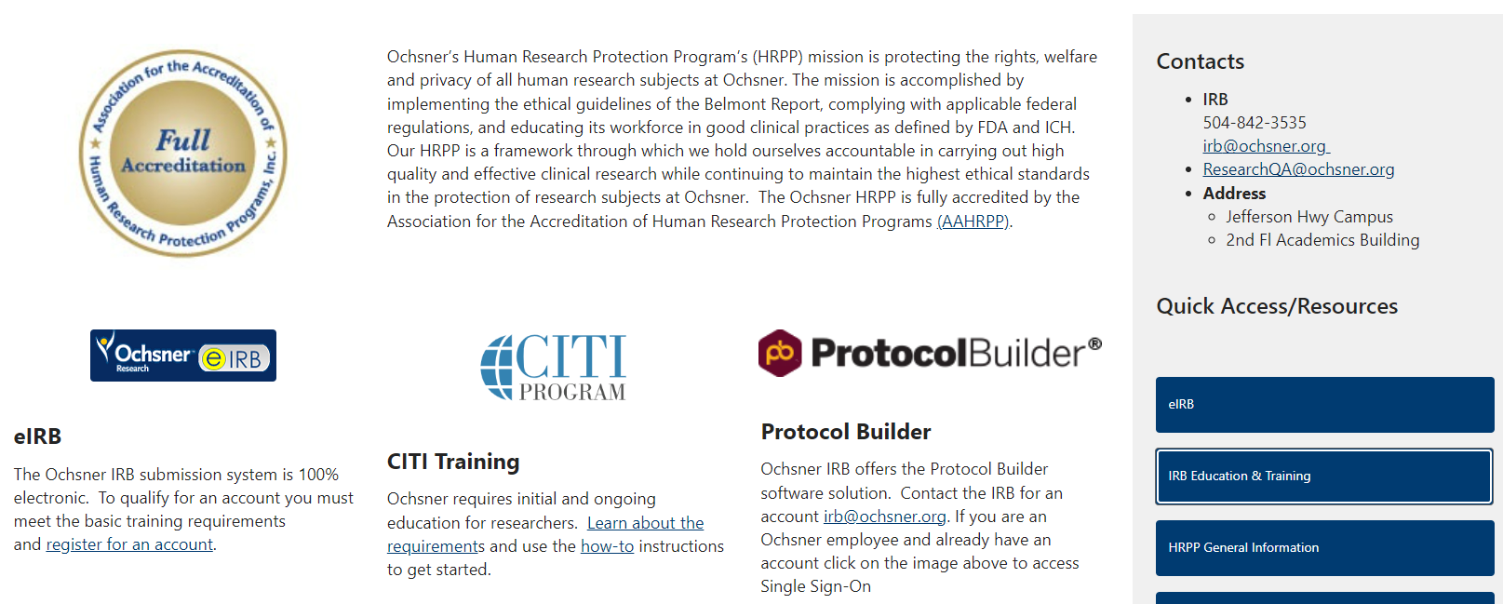
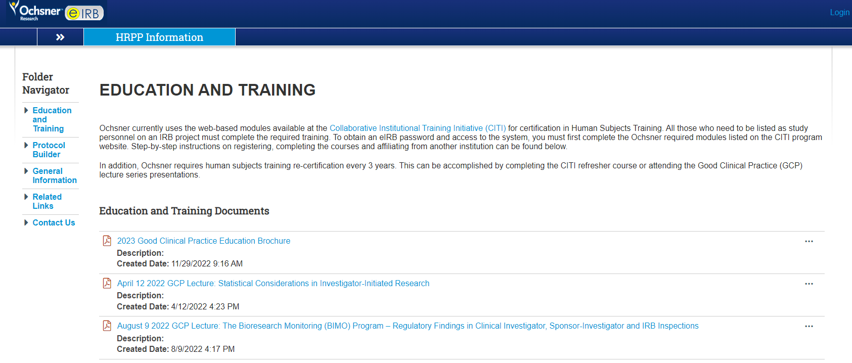
How Do I Complete CITI Training?
Go to the HRPP website and
click on IRB Education &Training
Click on Collaborative Institutional
Training Initiative (CITI)
Create a login
Affiliate with Ochsner Clinic Foundation
and the required modules will load

Slide 14
I want to do ask a Research Question: How do I formulate a testable hypothesis?
PICO Strategy
P (Patient or Population)
I (Intervention)
C (Comparison)
O (Outcome)

Slide 15
How do I formulate a testable hypothesis? Migraine Example
For patients with migraine, does eptinezumab versus standard oral treatment affect migraine frequency?
P (Patient or Population) = patients with migraine
I (Intervention) = 2 infusions of eptinezumab over 6 mo
C (Comparison) = standard oral preventative treatment
O (Outcome) = average number of migraines per month

Slide 16
How do I formulate a testable hypothesis? Hypertension Example
For adults with hypertension, does participation in the Ochsner Digital Hypertension Program lower blood pressure?
P (Patient or Population) = people ≥ 18 yr. with blood pressure ≥ 130/80
I (Intervention) = active participation in Digital Hypertension
(weekly BP entries)
C (Comparison) = prescription and follow up visits every 3 months
O (Outcome) = blood pressure 6 months after enrollment in Digital Hypertension or initial hypertension prescription

Slide 17
How do I formulate a testable hypothesis? Post-op Pain Example
For adult females receiving a pelvic procedure, do non-narcotic medications versus narcotic medications result in different post-op pain scores?
P (Patient or Population) = females ≥ 18 yr. receiving a pelvic procedure for either benign
or malignant reasons
I (Intervention) = any post-op dose, formulation, route or duration of non-narcotic medication
C (Comparison) = any post-op dose, formulation, route or duration of narcotic medication
O (Outcome) = avg day 7 subjective pain rating score entered 3x/day for 7 days post-op

Slide 18
How do I formulate a testable hypothesis? GYN Surgical Technique Example
For adult females undergoing gynecological surgery, is there a difference in adverse events between robotic surgery versus other surgical approaches?
P (Patient or Population) = females ≥ 18 yr. receiving gynecological surgery for either benign
or malignant reasons
I (Intervention) = robotic surgery
C (Comparison) = laparoscopic, abdominal, or vaginal gynecological surgery
O (Outcome) =# of Adverse Events (infection, mesh erosion, hemorrhage, GI/GU injury, VTEs)

Slide 19
Research Question: Start with a Literature Search
Has my question been answered in the literature?
If I cannot find the answer, will others learn from my results? Novel & relevant
What if only one publication offers an answer to your question – is a second study important? Generally speaking, yes – it is important to try to replicate research findings.
If your question has been reliably answered, can you extend your question to contribute to the scientific literature? What hasn’t been examined? Will my patient population add something unique to the reported findings?

Slide 20
Can I use the same (PICO) strategy to do a literature search?
For patients with Hyperkinetic movement disorders, does botulinum toxin injection (as opposed to no Tx) improve functional outcomes?
P (Patient or Population) = Patients with Hyperkinetic movement disorders
I (Intervention) = botulinum toxin injection
C (Comparison) = no injection
O (Outcome) = functional testing

Slide 21
Combine PICO Terms to Build Search For patients with Hyperkinetic movement disorders, does botulinum toxin injection (as opposed to no rx) improve functional outcomes?
1) Myoclonus or Tremors or Dystonia
2) Botulinum Toxins
3) Combine 1 and 2
("Myoclonus or Tremors or Dystonia" and "Botulinum Toxins“)
Patients
Intervention
Search Terms

Slide 22
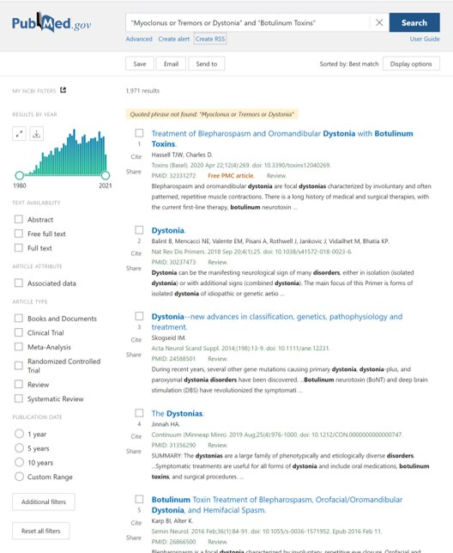
Limit Retrieval to Target Relevant Literature
Age Group
Human
Animal
Language
Publication Type
Letter, article, etc.
Methodology of Study
Article Type
Limit by text availability​
e.g., if you only want full text or free full text
Limit by type – like “Clinical Trials”
What are additional filters?

Slide 23
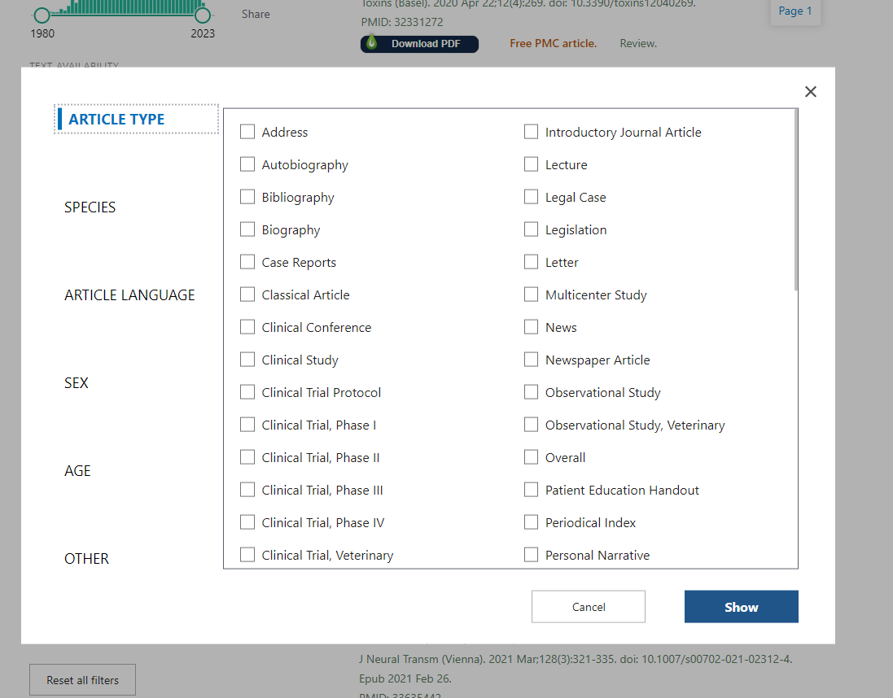
This is what pops up when you click “Additional Filters”
There are a number of clinical article types that will narrow your search, as well as other choices mentioned: age, sex, language, etc.

Slide 24
I Want to Perform Human Subjects Research
Complete required training
(e.g., CITI)
01
Develop a Hypothesis
02
Do a Literature Search
03

Slide 25
I Want to Perform Human Subjects Research
If you are a trainee, have you selected a research mentor?
Choose a Study Design
Develop a Protocol

Slide 26
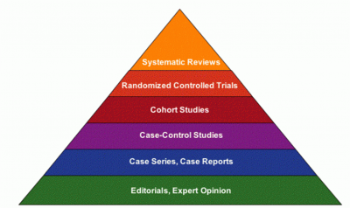
Hierarchy of Evidence for Questions About Interventions
Notes:
Books and traditional (non-evidence-based) reviews provide some guidance for the management of first unprovoked seizures, and comment on the risk of recurrence. However, these sources assess the existing evidence with variable rigour, and usually do not describe the quality of the evidence underpinning their statements. Remember: a basic tenet of EBM is that there is a hierarchy of evidence...

Slide 27
Observational Studies
Observational studies: exposure (e.g., treatment) not assigned by investigator
Descriptive: do not test a hypothesis; collect information of the distribution of disease patterns across demographics or clinical characteristics
Analytic: do test a causal hypothesis of the relationship between exposure and disease​

Slide 28
Analytical Observational Studies
TEST a causal hypothesis of the relationship between exposure and disease​​
Cohort studies​
retrospective ​
prospective
Case-Control Studies

Slide 29
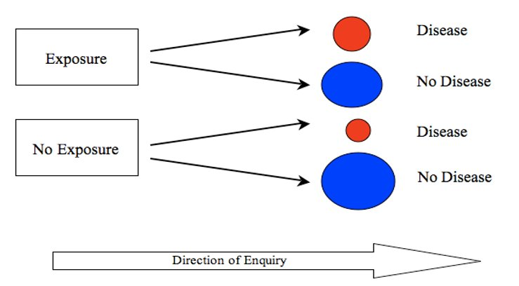
Cohort Study Design
Note the direction of inquiry:
starting with exposure and asking about the outcome
Can be retrospective or prospective

Slide 30
Cohort Study Example
Direction of Inquiry
Retrospective
In people with exposure to known environmental toxins, was there an increased risk for developing ALS?
Take a known historical exposure and look forward in time to see who developed ALS and if there was a difference in risk based on exposure history.
Prospective
In people who use e-cigarettes, will there be an increased risk in developing lung cancer compared to those who abstain from traditional cigarettes and e-cigarettes?
Take a current known exposure and follow people into the future to document whether they develop lung cancer.

Slide 31
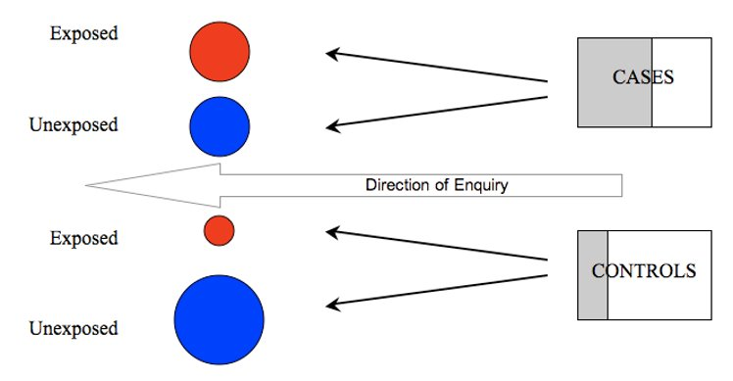
Case-Control Study Design
Note the direction of inquiry:
starting with outcome and asking about the frequency of exposure and non-exposure
Retrospective studies by nature.

Slide 32
Case Control Study Example
Direction of Inquiry
If someone has valvular heart disease, what are the odds that they were treated with a dopamine agonist?
8.78 times greater than if you do not have valvular heart disease
Schade R, Andersohn F, Suissa S, Haverkamp W, Garbe E. Dopamine agonists and the risk of cardiac-valve regurgitation. N Engl J Med. 2007 Jan 4;356(1):29-38. doi: 10.1056/NEJMoa062222. PMID: 17202453.

Slide 33
I Want to Perform Human Subjects Research
If you are a trainee, have you selected a research mentor?
Choose a Study Design
Develop a Protocol

Slide 34
Ready to Develop My Protocol
Accessing Protocol Builder
Go to the HRPP website and click on eIRB
Click on Protocol Builder
Use your SSO to access
Click Start Document to begin a
new protocol
All your projects are saved

Slide 35
I Just Need to Complete a Chart Review
Try the Residency Research Protocol Form
2-page outline of the required components of a protocol for most chart reviews
Includes a data dictionary to help you identify exactly which
data elements you need for your project
Reach out to your Directors; they can share a Word version of this form and provide feedback on your protocol before you submit it to the IRB

Slide 36
Create Data Collection Tools
Questionnaires
Excel spreadsheets
REDCap data forms
Place a request through The Hub to receive access to REDCap (an ‘existing application’)
Anything that a participant engages with must be included in your protocol and reviewed by the IRB, such as surveys, scales and questionnaires
Other data collection tools should be described in your protocol, including your data security plan and data sharing plan (if applicable)

Slide 37
Other Considerations for Human Subjects Research
Should I register my study with clinicaltrials.gov?
Generally, yes if using drug/device and/or an interventional trial
Can I bill insurance for research activities?
Work with Research Finance
Can I share data with collaborators?
If outside Ochsner, may need a data use agreement
Should I consult with Biostats?
Design phase is the perfect time to ask for help
Do I need a consent form?
Prospective studies may require a consent form

Slide 38
I Have a Protocol – What’s Next?
Go to the Office of Epidemiology & Biostatistics and submit a request for help
Submit the protocol through eIRB
Register for an account if you are a first-time user
Trainees and collaborators may register using their professional email address (does not have to be an Ochsner email)

Slide 39
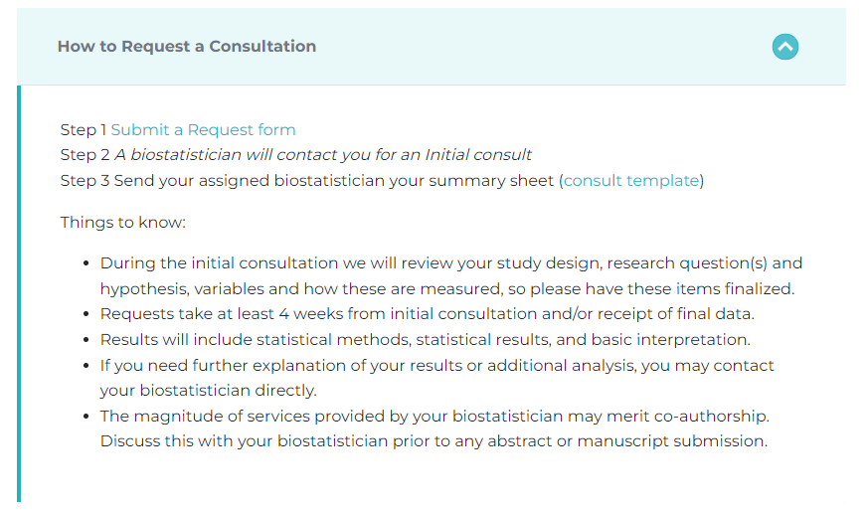
You can access the Biostats site externally through the research.Ochsner.org site
or through their Sharepoint site

Slide 40
Submitting Your Protocol through eIRB
Go to the HRPP site and click the link for eIRB on the right
On the next page, click Login at the top right and use your Ochsner SSO to login
Go to the IRB tab and choose
“Create New Study” on the left

Slide 41
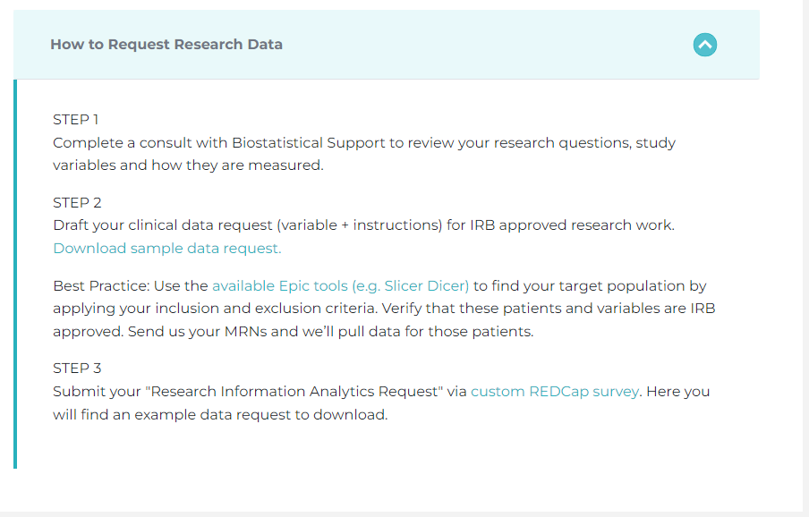
IRB Review is Complete & I’m Ready to Begin
If your study meets the definition of Human Subjects research, you will need a study binder for keeping records of your study activities, including deviations from your protocol, adverse events, training and communication with your research team, enrollment, etc.
If you need a data pull, go to the “Research Information Analytics” link on the Outcomes Research page on the research.Ochsner.org site.
Download a data request template and submit it via the REDCap survey form.

Slide 42
Data Collection is Complete: I Need Help with My Analysis
Go back to the Biostatistics site and submit a form for help with analysis and interpretation

Slide 43
I’m Ready to Share My Results
Prepare to share your results using de-identified data
Poster presentations often begin with creating and submitting an abstract
Introduction/Background
Purpose/Hypothesis
Design/Methods
Results/Conclusion
Manuscript preparation follows the same general format
Be sure to ask your mentor, colleagues, and/or clinical research directors to review your work and provide feedback

Slide 44
Choosing the right journal
Use your references to help determine the right readership
Is your target journal a fit for your topic
Does the journal publish findings based on your methods (e.g., not all Journals publish case studies)
Identify society journals based on your subspecialty (e.g., AHA has several, including Stroke, Circulation, and Hypertension)
Try a journal finder
Elsevier journals: https://journalfinder.elsevier.com/
Wiley journals: https://journalfinder.wiley.com/search?type=match
Springer journals: https://journalsuggester.springer.com/

Slide 45
Resources to be Shared
Emailed to invitation list
Quick Start Guide with Links to Research Resources
Resident Research Protocol Template
Go to https://medical-school.uq.edu.au/ochsner-student-research-hub for Medical Student guidance and access to this PowerPoint.

